Slide 1
American History
1
Talk 27: Roaring Twenties (1921-1929)
Part Three

Slide 2
Race, gangsters and speculation

Slide 3
Race conflict 1920’s
“Scientific racist theory” 1890’s
Progressivism and “White Nationalism”
The Great Migration
Mass marketing and “the Lost Cause”

Slide 4
The “Lost Cause” Myth
Civil War as taught 1870- 1980’s a “war between the states”
….not a war about slavery
….Reconstruction an abomination
….The South as victim…perpetuator
….Confederates “heroes” fighting for their rights
….Northern victory ‘corrected” by “Jim Crow” laws
View unchanged till1990-s….but resurrected by MAGA

Slide 5
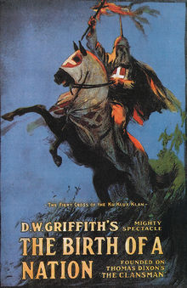
Hollywood Blockbuster 1915 film …..seen by millions…becomes “history” …Woodrow Wilson in White House …most popular and dangerous film in US history

Slide 6
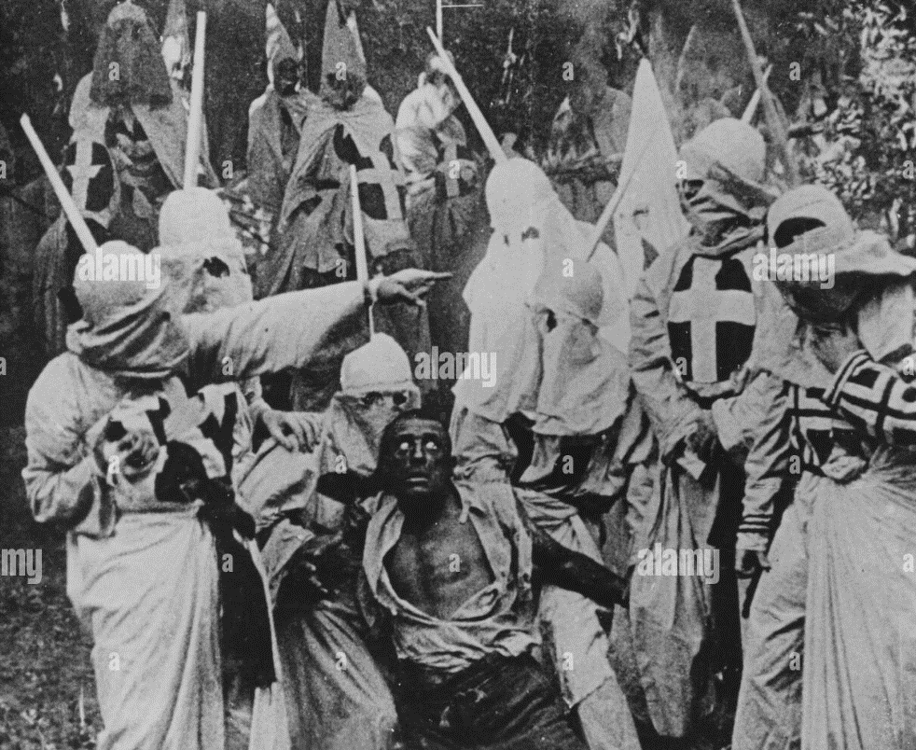
Birth of Nation: KKK capture Black rapist

Slide 7
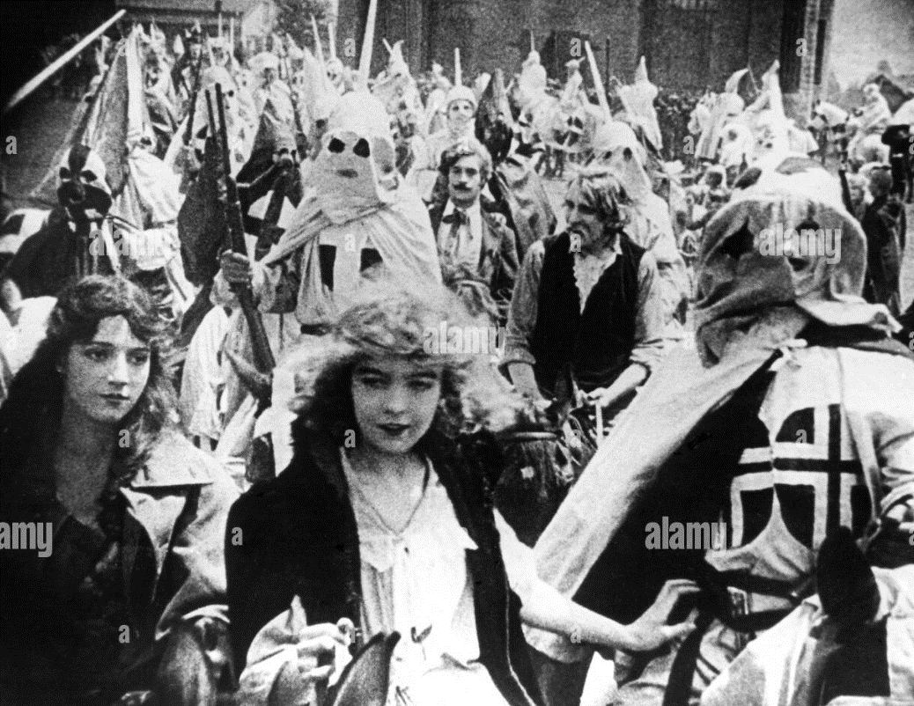
KKK rescue virtuous Southern women

Slide 8
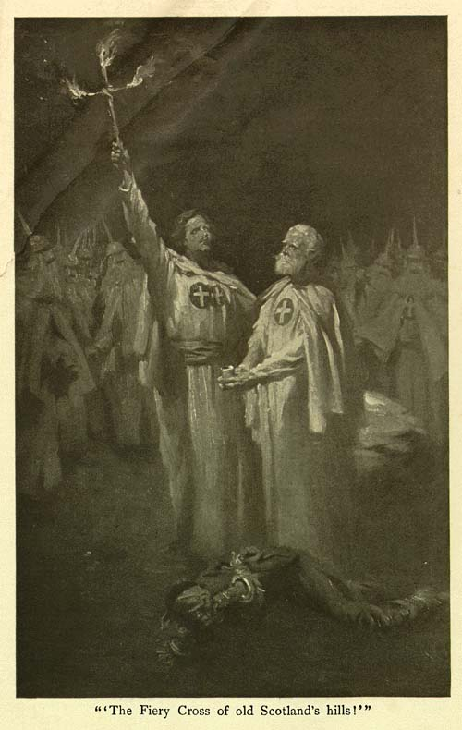
Confederate Propaganda
Front page of “The Klansman”
..saving the virtue of southern women
Deifying the Confederate leaders

Slide 9
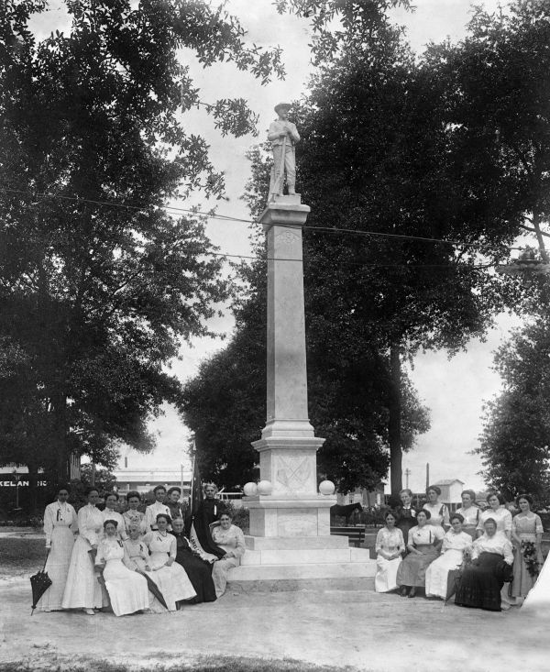
Memorials movement ….United Daughters of the Confederacy memorials movement (1915-1920)

Slide 10
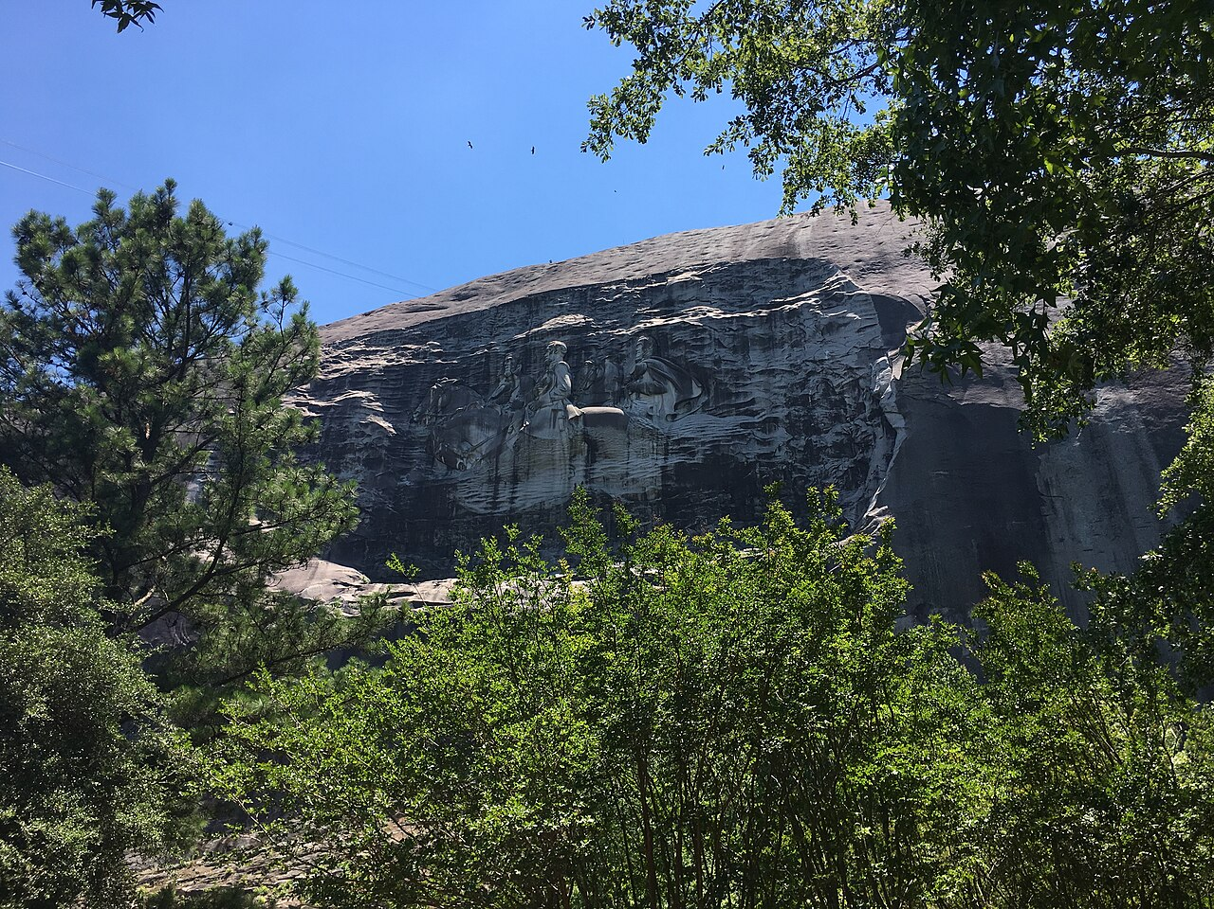
Stone Mountain monument ..started 1915…completed 1972

Slide 11
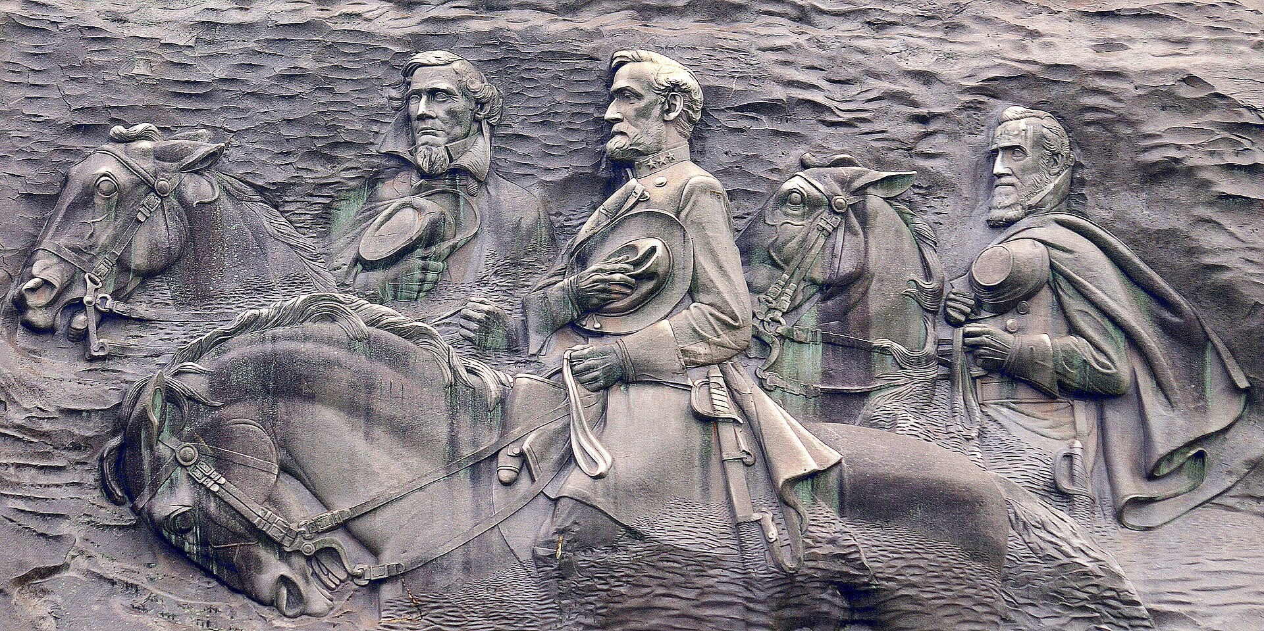
Generals heroes….not traitors

Slide 12
Klu Klux Klan Version 1.0 (1866-1870)
Post Civil war Terrorist group resisting Northern occupation & reconstruction War
Murders (white) “Northern Freedman’s Bureau” employees …blacks intimidated, seldom murdered
Local to South…no national organisation …mimic “Knights of Malta”…50, 000 member…secret men's groups
Suppressed by President Grant 1870

Slide 13
KKK version 2.0 (1915-1940’s)
National Organisation led by Protestant Minister (Reverend Simmons)
Scientific Racism based
Fuelled by “Great migration” of blacks from South
Social movement with 3-5 million members mid 1920’s
Adopt costumes shown on “Birth of a Nation”… made up rituals
Targets both Catholic and Blacks…intimidates former, lynches latter
Peak member 1925…scandals (sex & booze)…rapid decline, but remains threat

Slide 14
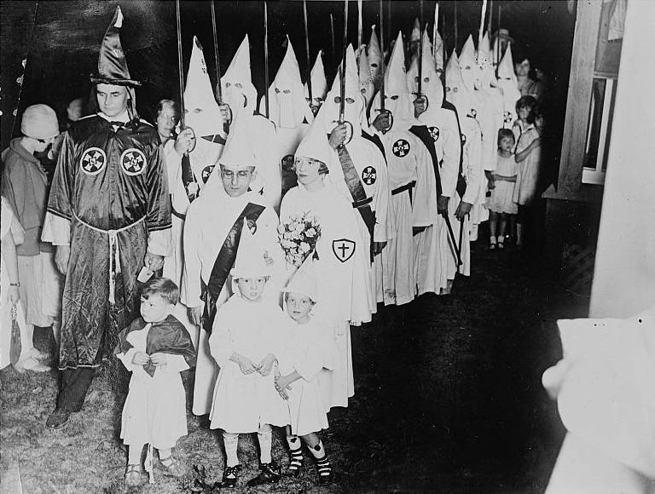
…a family affair

Slide 15
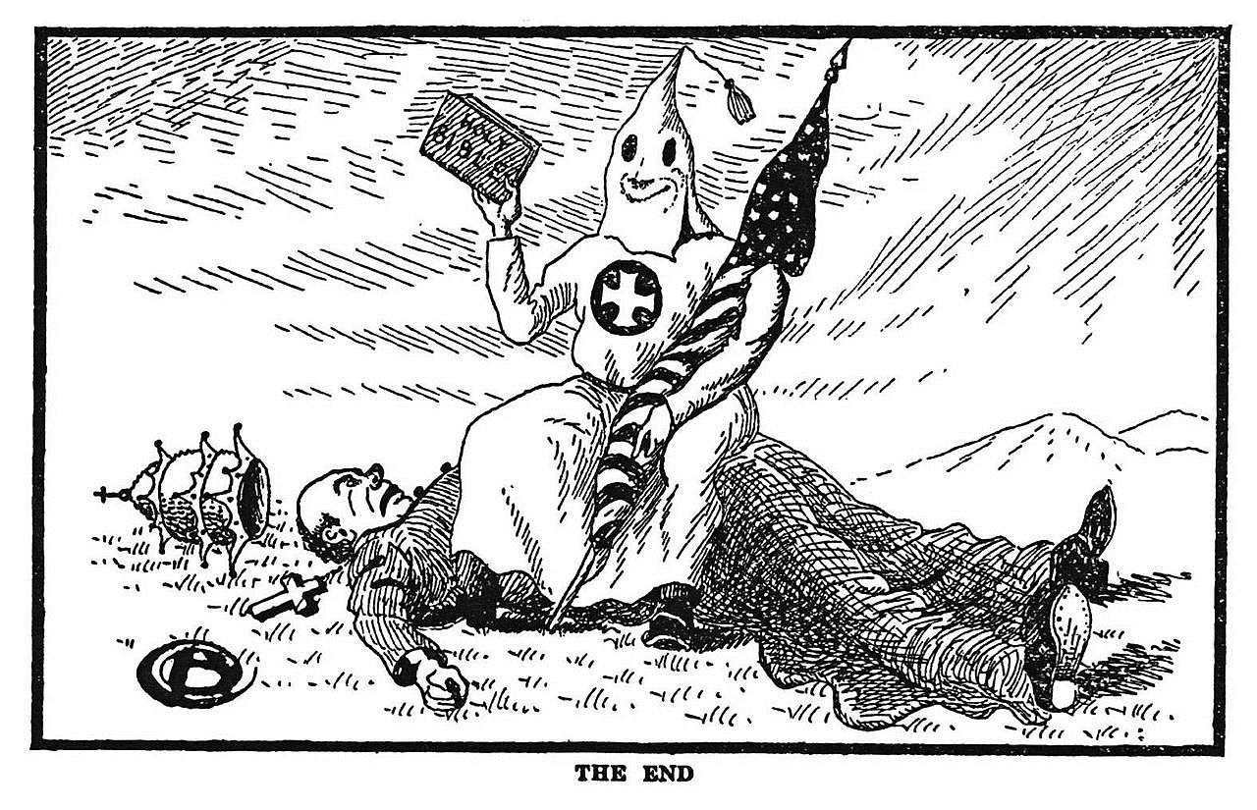
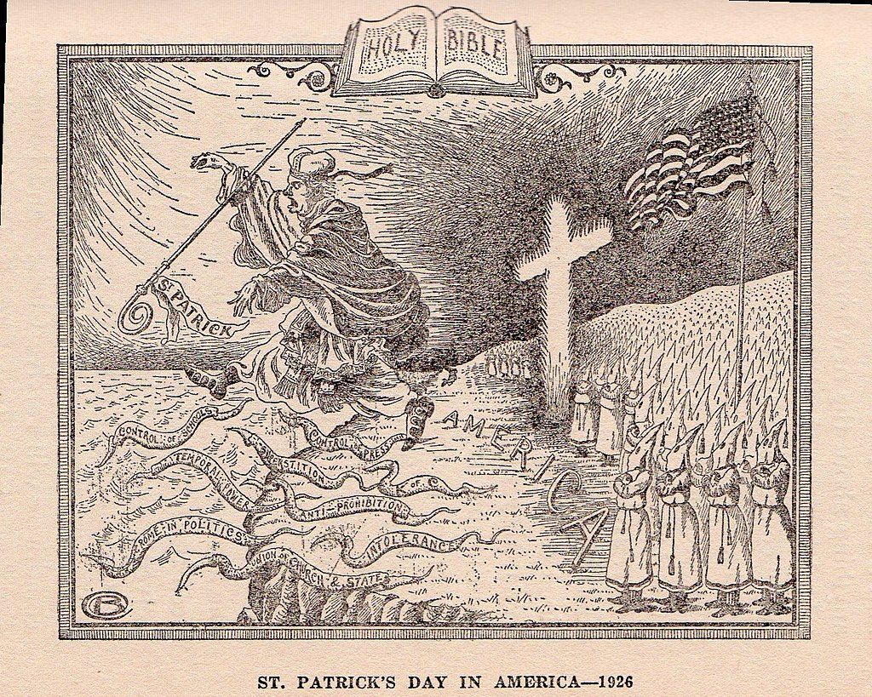
Anti Catholic propaganda

Slide 16
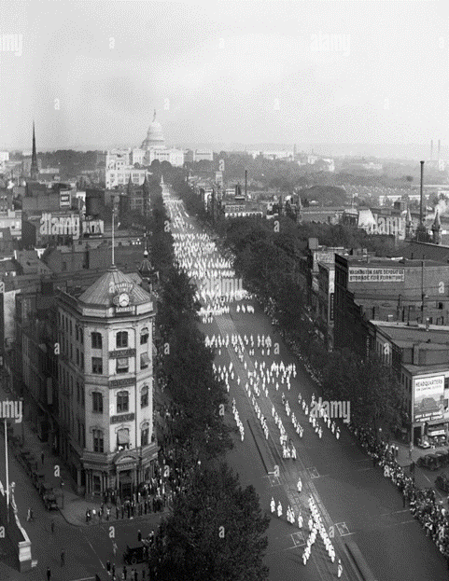
March on Washington 1925

Slide 17
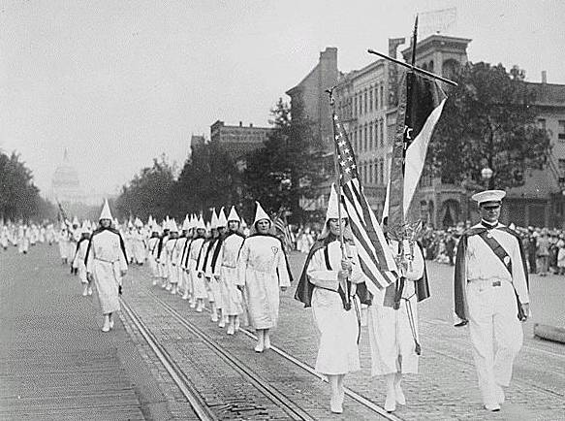
Women to the fore ! ….Washington 1925

Slide 18
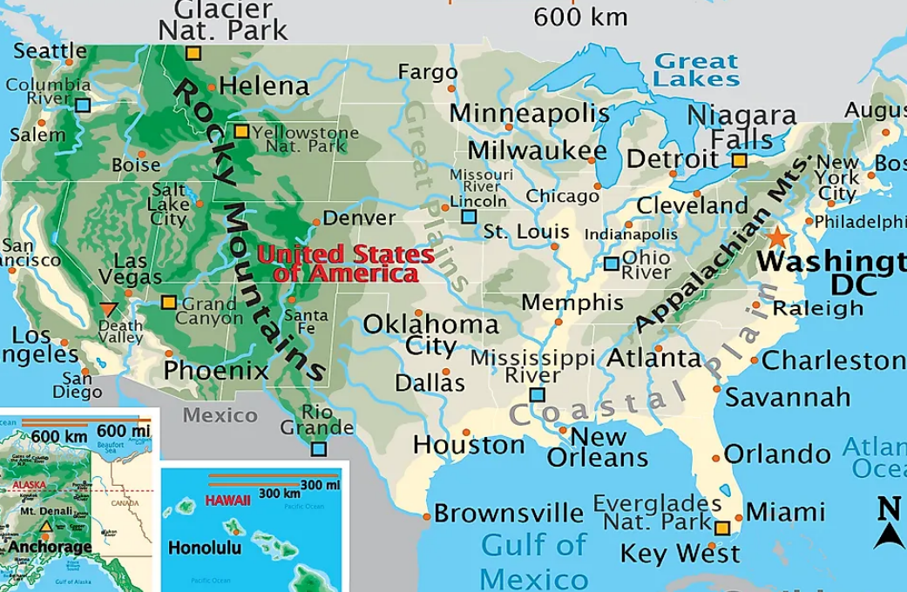
Tulsa 1921
City of 100,000 including
….10,000 blacks
….Segregated since 1890’s
Long established Black population
…….migration post civil war
Tulsa
Tensions rise
….Black soldiers return from war
….business down turn
…3,000 KKK members 1921

Slide 19
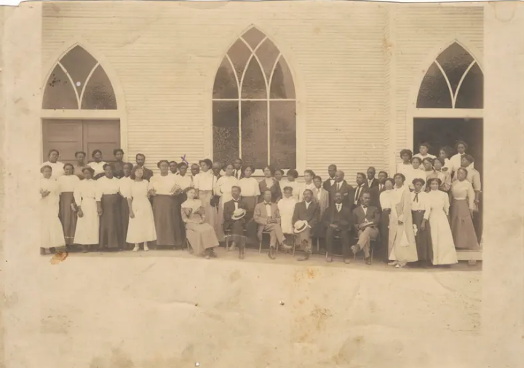
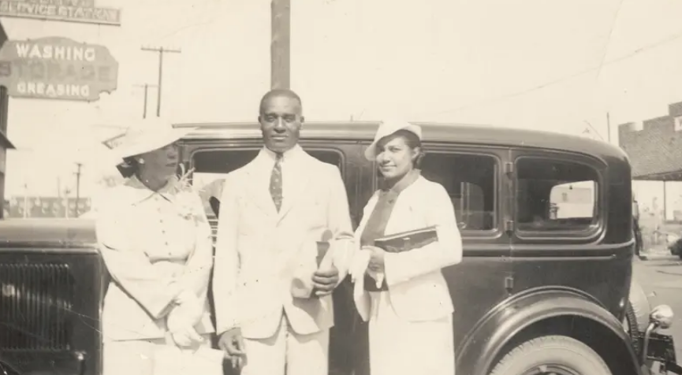
Tulsa Greenwood community …prior to 1921

Slide 20
Tulsa riot of 1921 (massacre”
Segregated neighbourhood/ no “coloured” facilities
Lift incident…riot….newspaper headlines
White militia attempt lynching…..black veterans to defence
Governor calls in militia, use of aircraft to bomb (?)
At least 300- killed (50 White) 800 wounded (10,000 blacks homeless)
………………….assets stolen)
Omitted from US history books till 2000’s

Slide 21
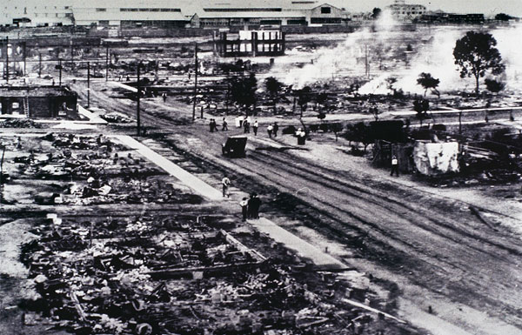
Green wood after ‘massacre”

Slide 22
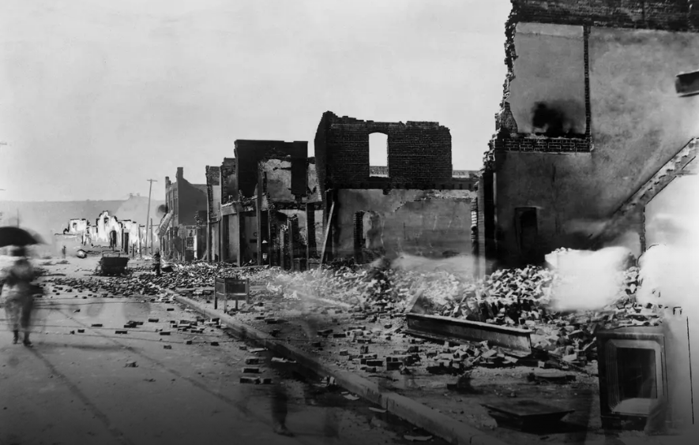

Slide 23
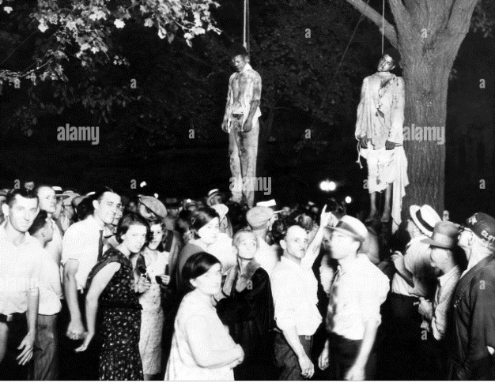
Race riots/ lynching occur across during 1920’s ….public affairs, media covered, most in North

Slide 24
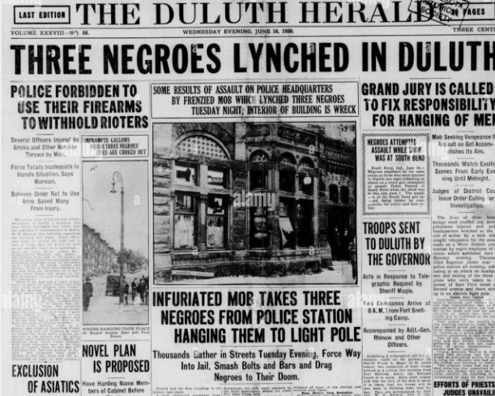
Favorable news coverage

Slide 25
Gangsterism ….problems of prohibition

Slide 26
Prohibition
18th Amendment ratified January 16th 1919: alcohol banned January 1st, 1920
Political view “"there is as much chance of repealing the Eighteenth Amendment as there is for a humming-bird to fly to the planet Mars with the Washington Monument tied to its tail."^{[69]}
Religious view: Billy Sunday: “The slums will soon be only a memory. We will turn our prisons into factories and our jails into storehouses and corncribs. Men will walk upright now, women will smile, and the children will laugh. Hell will be forever for rent.”
Initial response
Enthusiastic endorsement/ rise of private clubs “Speakeasies”
Affluent resort to stockpiles, build cellars, secure “medical exemption”
Wealthy Travel to Canada and Cuba ….the poor to Mexico
Enter the criminals

Slide 27
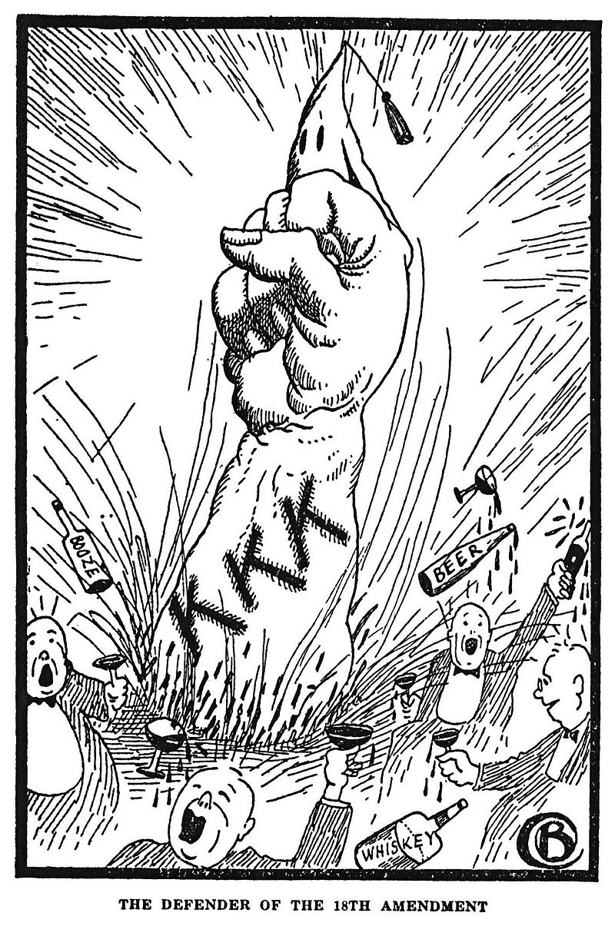
Supporting Prohibition …The “wets” & KKK

Slide 28
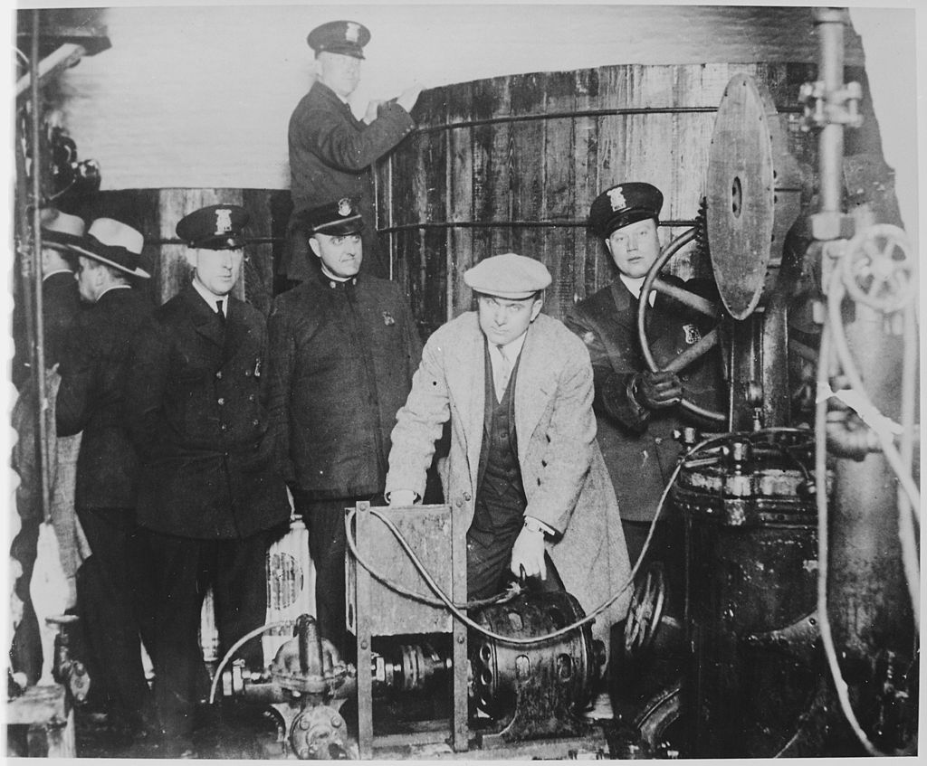
Enforcement enthusiastic….at first

Slide 29
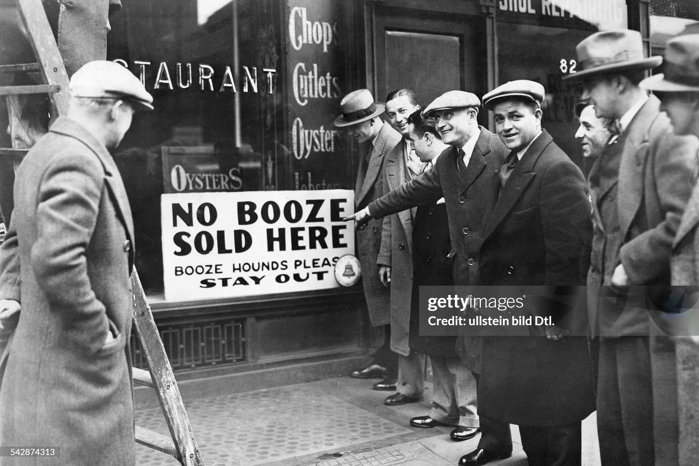
Restaurants comply…..at first

Slide 30
Prohibition impact (1)
Economic
250,000 jobs lost, Restaurants closed…uneconomic
Loss of taxable income (New York lose 75% of State Revenue
“Shadow economy” worth $15BN develops per year (20% of economy)
$300 million spent on enforcement, 3,000 agents, birth of FBI
Health
50% reduction in alcohol consumption …rising to 30% by late 20’s
Shift to spirits /hard liquor…easier to transport
Disastrous experiment to “de-nature” liquor….10,000 poisoned by Govt programme to contaminate stocks

Slide 31
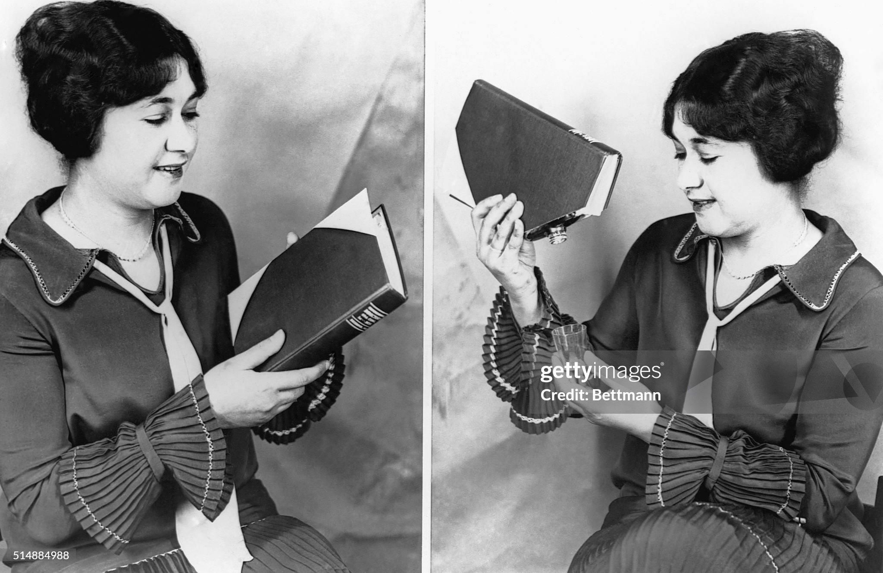
Hiding the booze (illegal to sell and deliver….not to drink!)

Slide 32
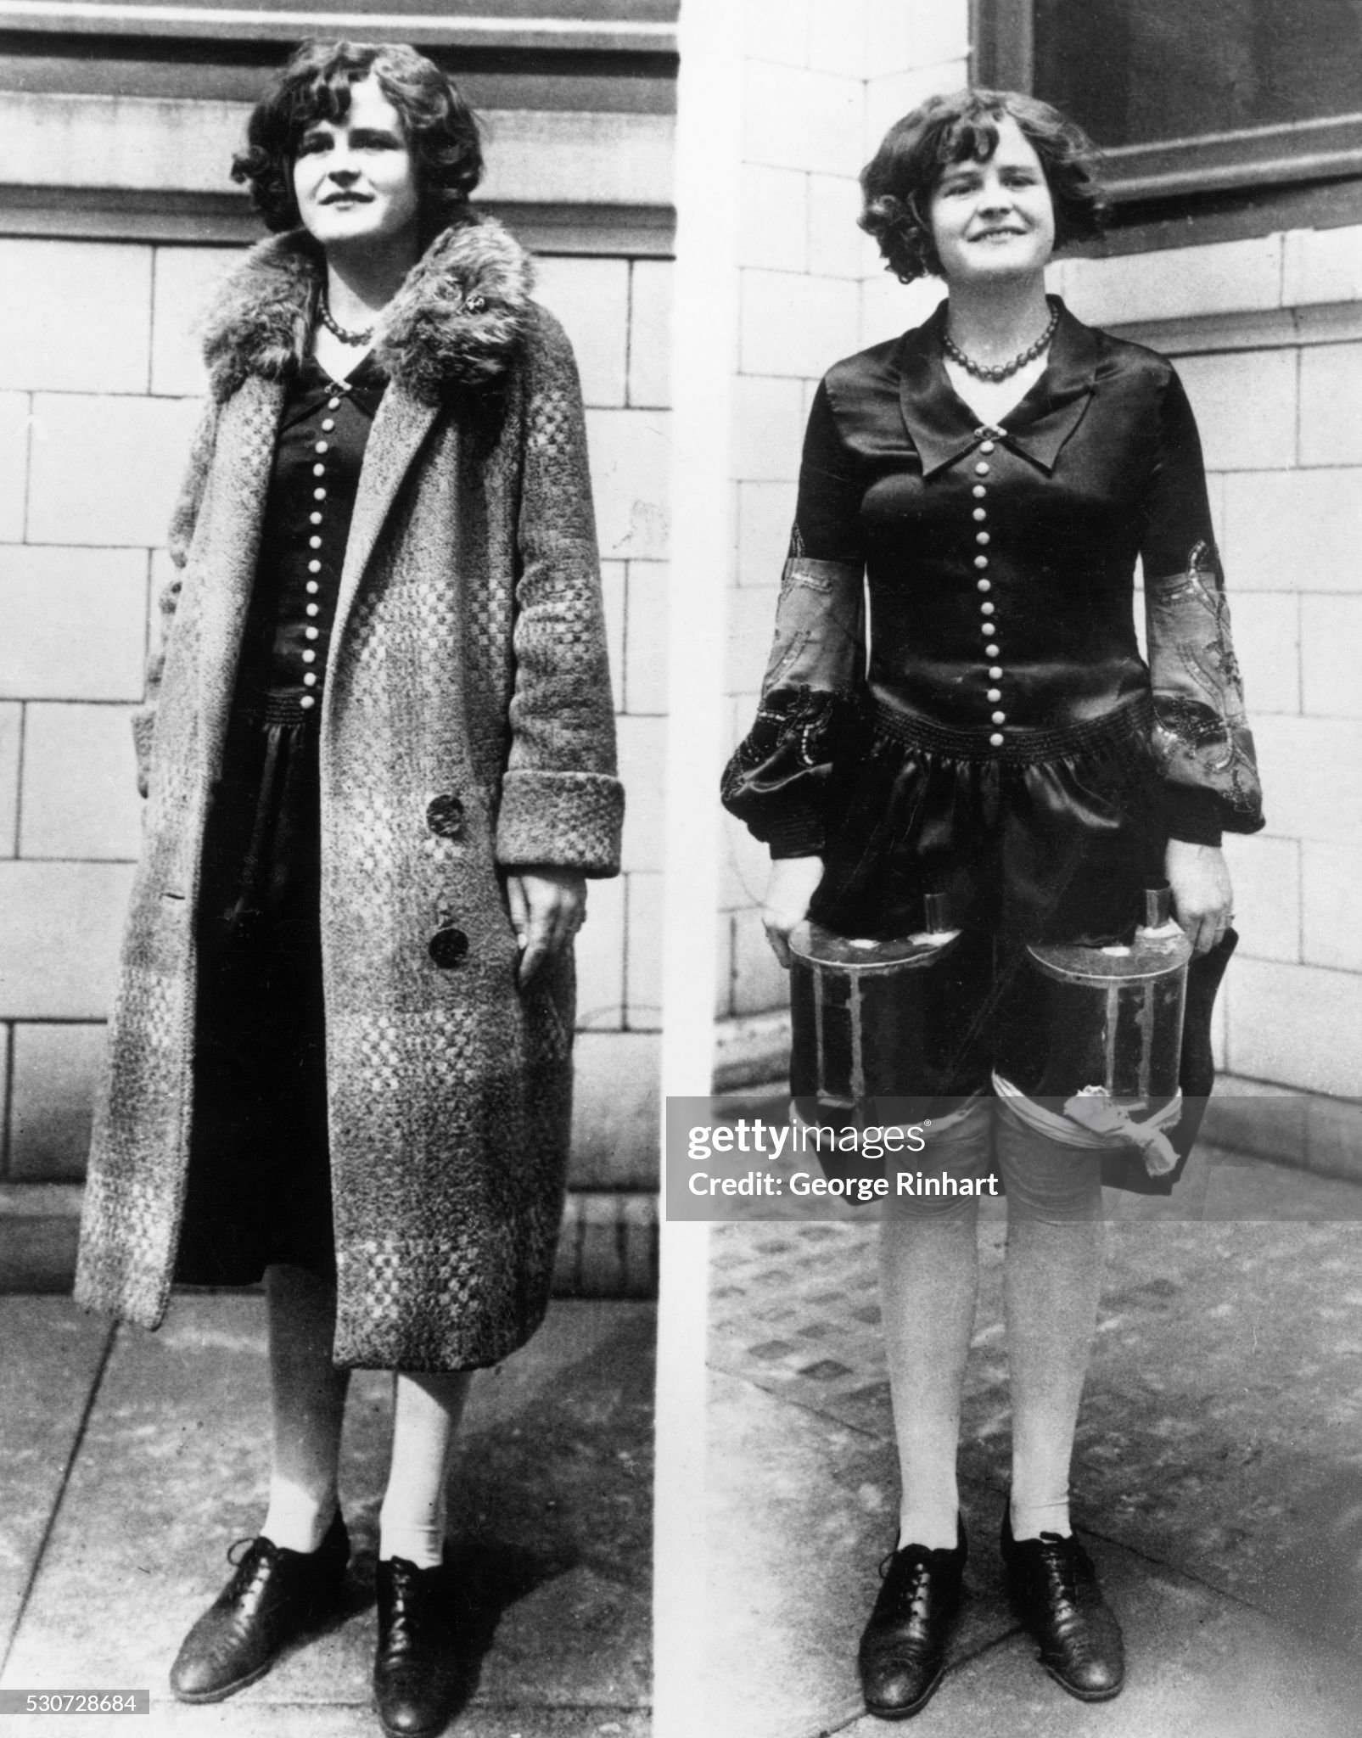

Slide 33
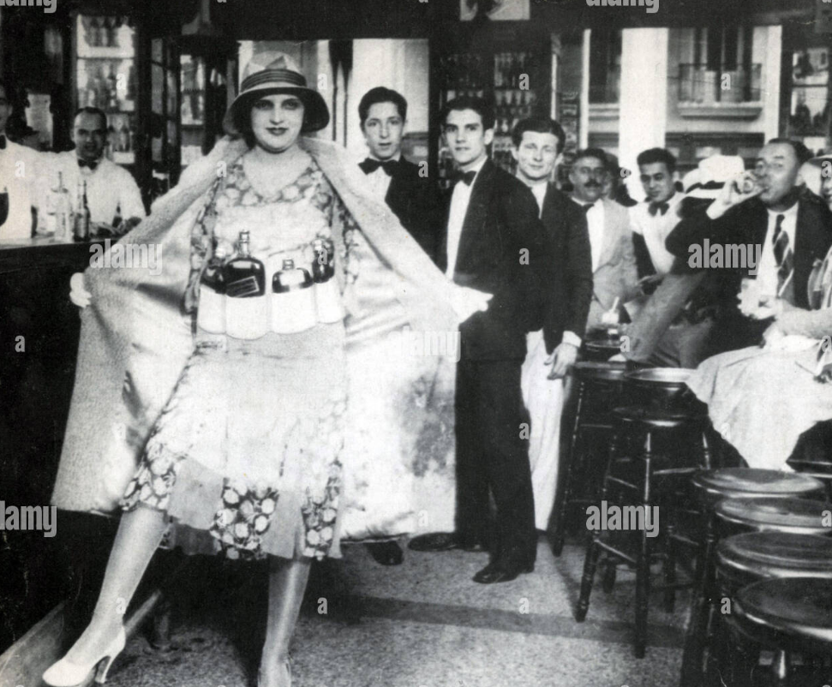
Speakeasies….10,000 in New York by 1926 ……collapse of enforcement

Slide 34
Political/ Social Impact
Conflict Religious, rural, populates vs urban, immigrant communities
Social division
No/light enforcement for wealth
Discrimination vs poor/minorities
Crime
Rise of wealthy and politically powerful crime lords ( Al Capone $1BN+ per year in earnings
“State capture” by crime lords of cities: Chicago, Detroit, Pittsburgh

Slide 35
Invitation to Crime
Italian immigrant community
Closely linked, secret societies
Marginal jobs, self help, brothel, gambling, narcotics
Self enforced, disciplined,
Prohibition opportunity
Cash business
Public complicit/ political influence
Logistics, smuggling Canada, Cuba

Slide 36
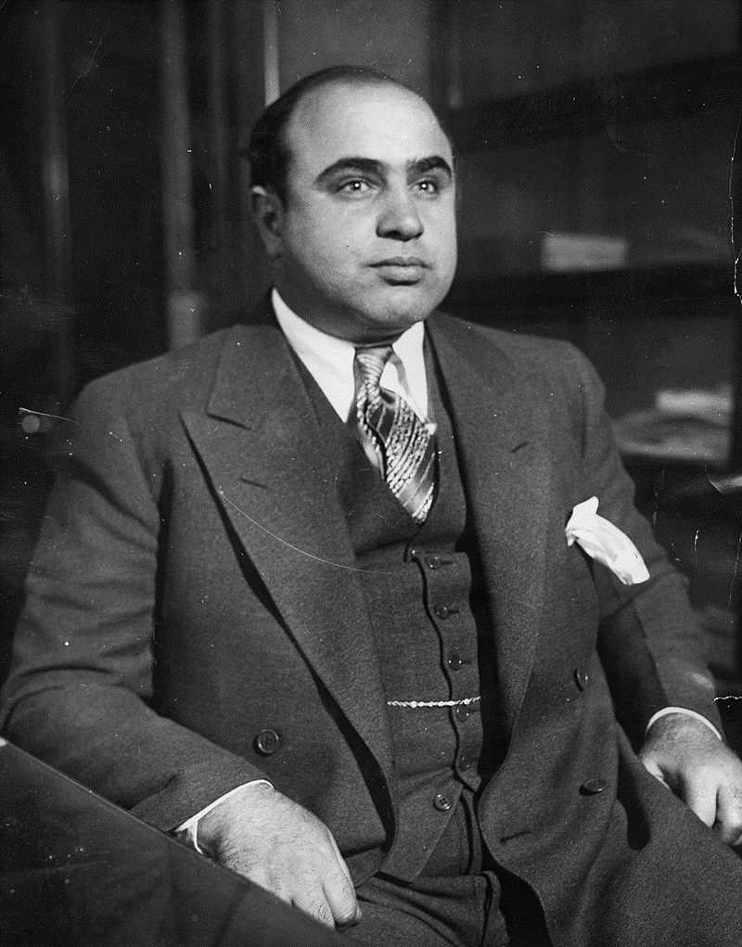
Alphonse Gabriel Capone
Born New York, Italian Immigrants
Gang member, bodyguard, moves to Chicago to work for …bouncer at brothel, promoted by boss
Organises distribution of spirits from Canada, bootlegging’
Responsible for deaths of more than 100 ,rivals across Chicago, personally batters to death 5 captured rivals
Jailed for tax evasion, never found guilty of murder ….dies of syphilis on release from prison due to income tax evasion
E
Al Capone 1899-1947

Slide 37
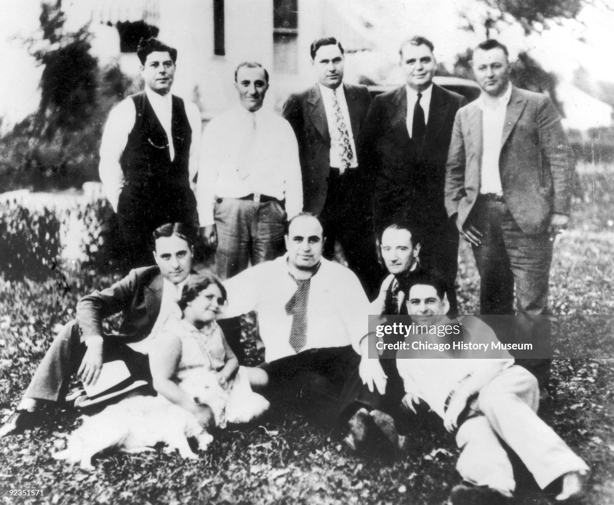
A family man

Slide 38
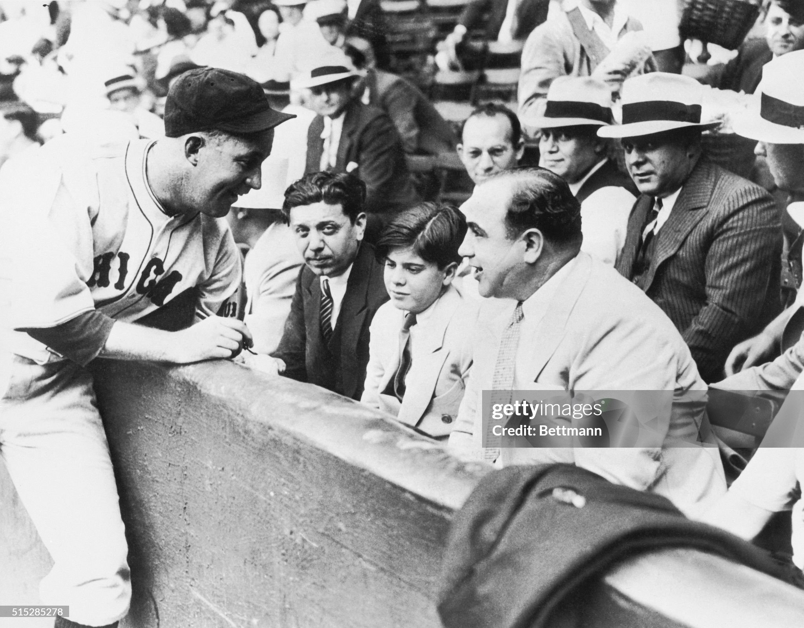
And celebrity…..at World Series Baseball game
There was also a dark side

Slide 39
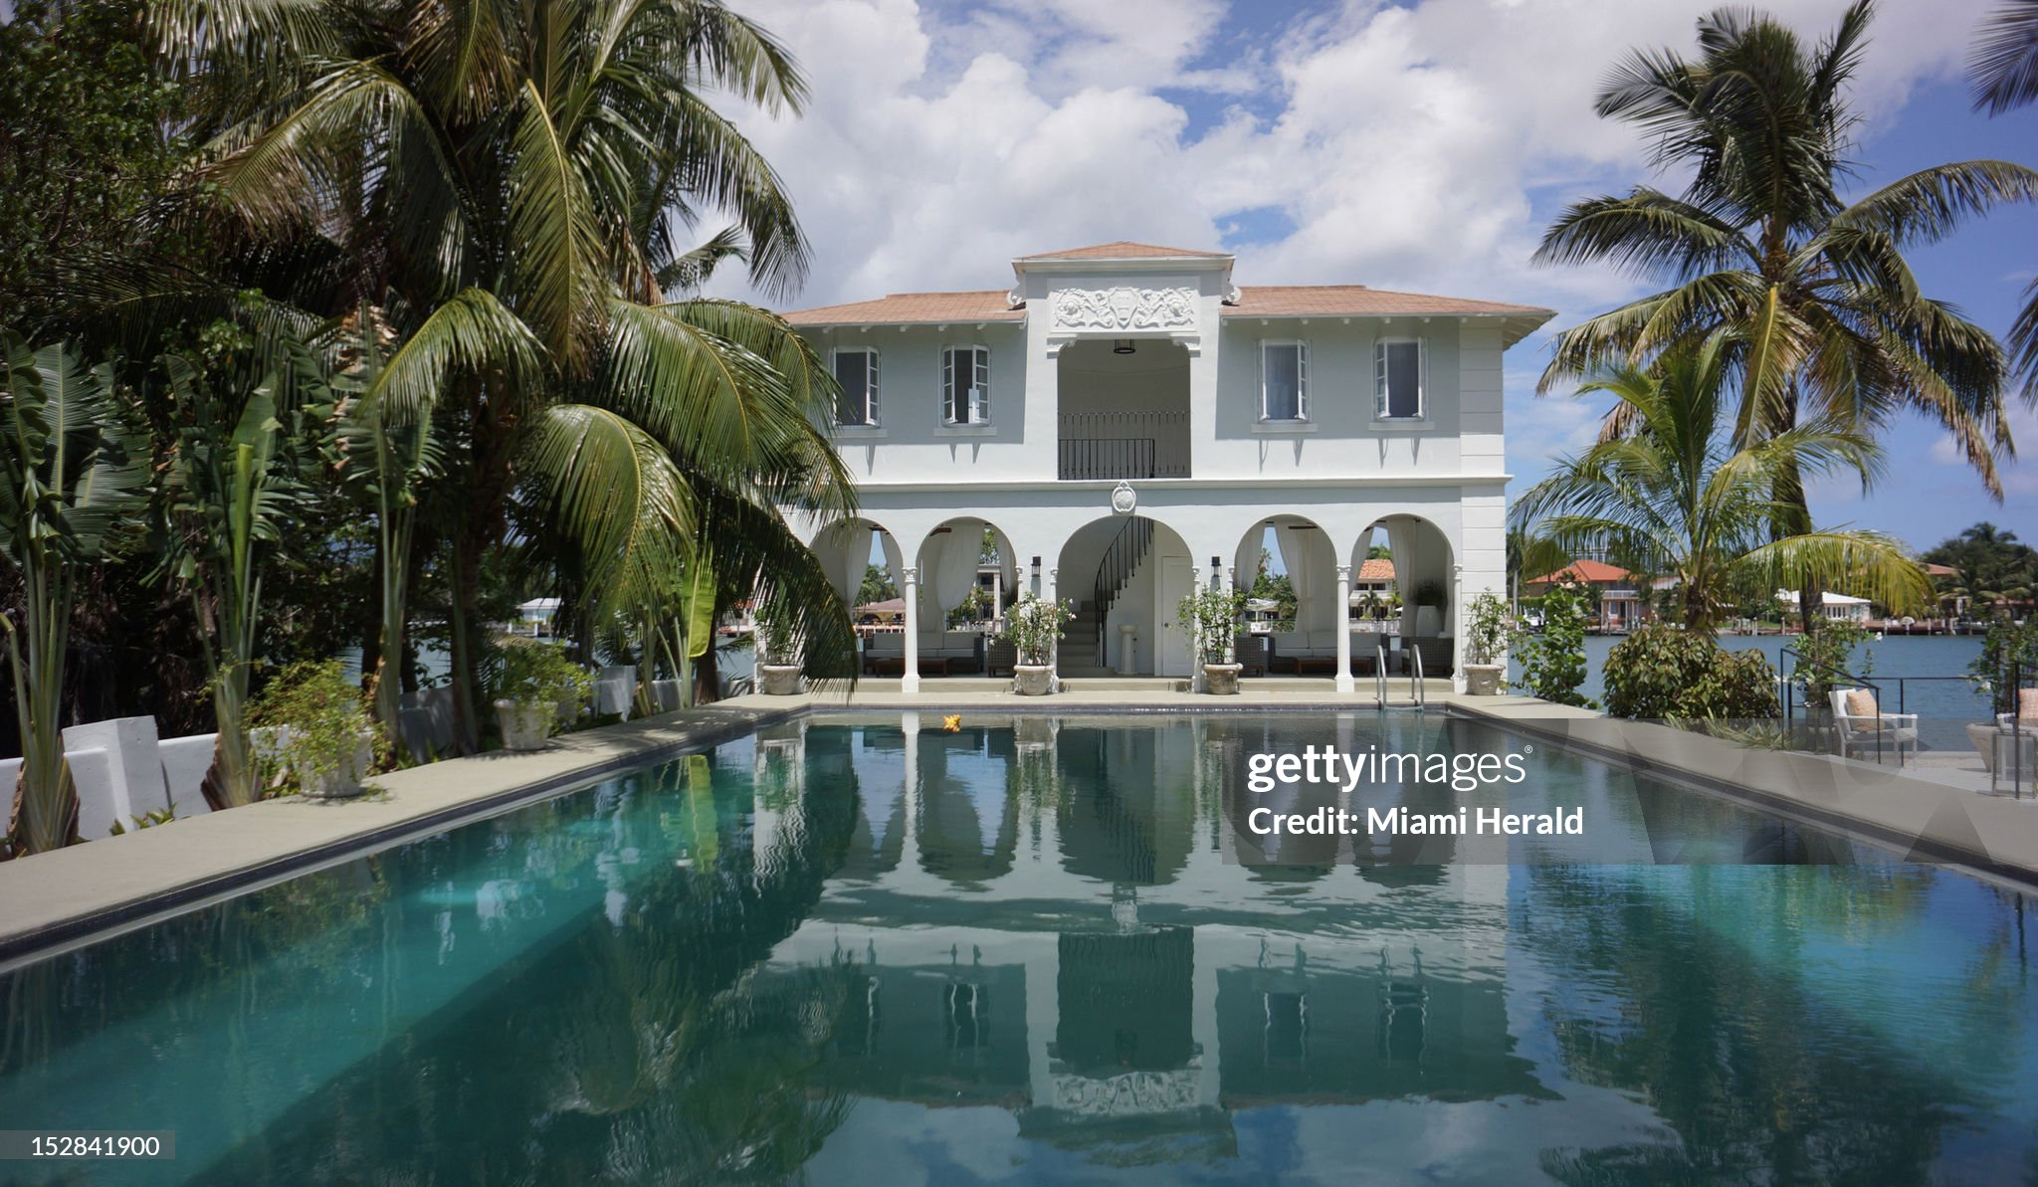
The rewards of crime (Capone’s Florida retreat)

Slide 40
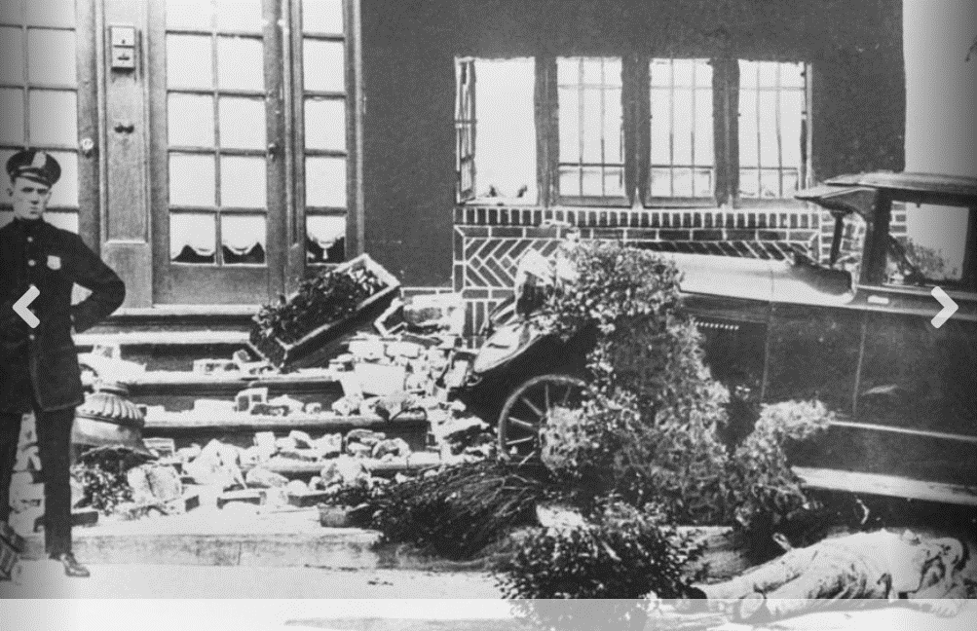
Removal of former boss ..Frankie Vale 1928)

Slide 41
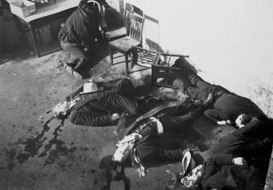
And rivals …the truce meeting that wasn’t…St Valentines Day Massacre 1928

Slide 42
Al Capone quotes
You accomplish more with a smile, a handshake, and a gun than you do with just a smile and a handshake.
I'm a kind person, I'm kind to everyone, but if you are unkind to me, then kindness is not what you'll remember me for
Some call it bootlegging. Some call it racketeering. I call it a business.

Slide 43
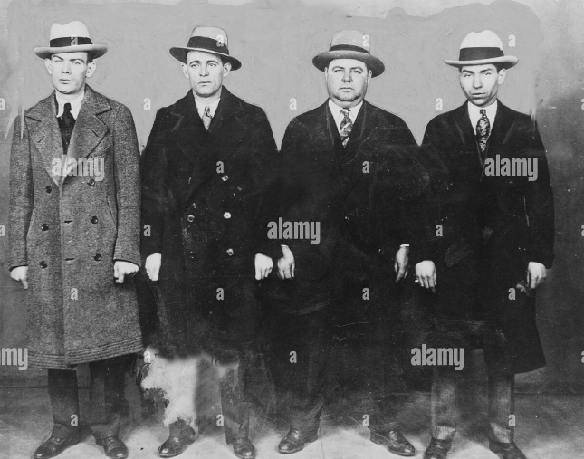
Mobsters …Lucky Luciano. Legs Ed Diamond, Fatty Walsh, …’celebrities” ……..glamorous, lethal, and ruthless

Slide 44
Prohibition and Crime
Homicides per 100,000
 | USA | UK
1900 | 1.2 | 1.0
1920 | 5.0 | 1.3
1930 | 9.0 | 1.2
2023 | 6.0 | 1.1
Some context…Prohibition…..no ‘civilians or families ” killed
During 2023 : .Jamaica …53/100,000, …. Mexico 26/100,000
“Shadow economy” grows to $15n per year, 20% of entire economy
Crime organisations “take over” several city governments (Chicago, Pittsburgh)
…contaminate unions, docks, trucking industries

